Slide 1

Flights Data Analysis
Varun Marvah (Varun.Marvah@gmail.com)

Slide 2
Sample 3
USA Flights Analysis -2013
Introduction:
This project is for project work as an assignment from UPX for Flights dataset shared by UPX
Flights dataset is having data about USA flights for year 2013
We need to understand, gain insights of data and present it in visual forms to end user
Challenges:
Dataset having Blank (Missing Values) in various columns – Dirty Dataset
Air Time (Arrival Time – Departure Time) values are not correct, calculations done on given dataset values of Airtime
Speed calculated on standard speed formula
3,36,776
USA Flights records of 2013

Slide 3
Sample 3
Dataset Before Cleaning
columnname | Column Name After Changes | Description | Count of Values | Missing Values | Updates
year | Flight_Year | Year of Flight | 336776 | 0 | #Flight_Year is having 0 missing values
month | Flight_Month | Month of Flight | 336776 | 0 | #Flight_Month is having 0 missing values
day | Flight_Day | Day of Flight | 336776 | 0 | #Flight_Day is having 0 missing values
dep_time | Departure_Time | Flight Departure Time | 328521 | 8255 | #Departure_Time is having 8255 missing values
sched_dep_time | Scheduled_Dep_Time | Scheduled Departure Time of Flight | 336776 | 0 | #Scheduled_Dep_Time is having 0 missing values
dep_delay | Departure_Delay | Departure Delay of Flight | 328521 | 8255 | #Departure_Delay is having 8255 missing values
arr_time | Arrival_Time | Flight Arrival Time Delay | 328063 | 8713 | #Arrival_Time is having 8713 missing values
sched_arr_time | Scheduled_Arrival_Time | Scheduled Arrival Time of Flight | 336776 | 0 | #Scheduled_Arrival_Time is having 0 missing values
arr_delay | Arrival_Delay | Arrival Delay in Flight ( In Minutes) | 327346 | 9430 | #Arrival_Delay is having 9430 missing values
carrier | Carrier | Carrier Name of Flight | 336776 | 0 | #Carrier is having 0 missing values
flight | Flight_Number | Flight Number | 336776 | 0 | #Flight_Number is having 0 missing values
tailnum | TailNumber | Tail Number of Flight | 334264 | 2512 | #TailNumber is having 2512 missing values
origin | Origin_Airport | Flight Origin Airport | 336776 | 0 | #Origin_Airport is having 0 missing values
dest | Destination | Destination of Flight | 336776 | 0 | #Destination is having 0 missing values
air_time | Air_Time | Air Time of Flight | 327346 | 9430 | #Air_Time is having 9430 missing values
distance | Distance | Distance travelled by Flight | 336776 | 0 | #Distance is having 0 missing values
hour | HOUR_Scheduled_Dep_Time | Hour of Scheduled Departure Time | 336776 | 0 | #HOUR_Scheduled_Dep_Time is having 0 missing values
minute | MINUTE_Scheduled_Dep_Time | Minute of Scheduled Departure Time | 336776 | 0 | #MINUTE_Scheduled_Dep_Time is having 0 missing values
time_hour | Hour_Minute_Scheduled_Dep_Time | Time of Scheduled Departure Time | 336776 | 0 | #Hour_Minute_Scheduled_Dep_Time is having 0 missing values
3,27,346
USA Flights records of 2013 (After clearing missing values)

Slide 5
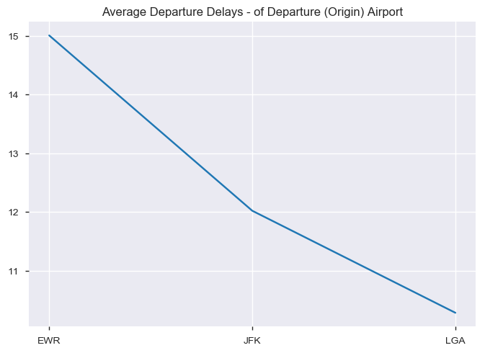
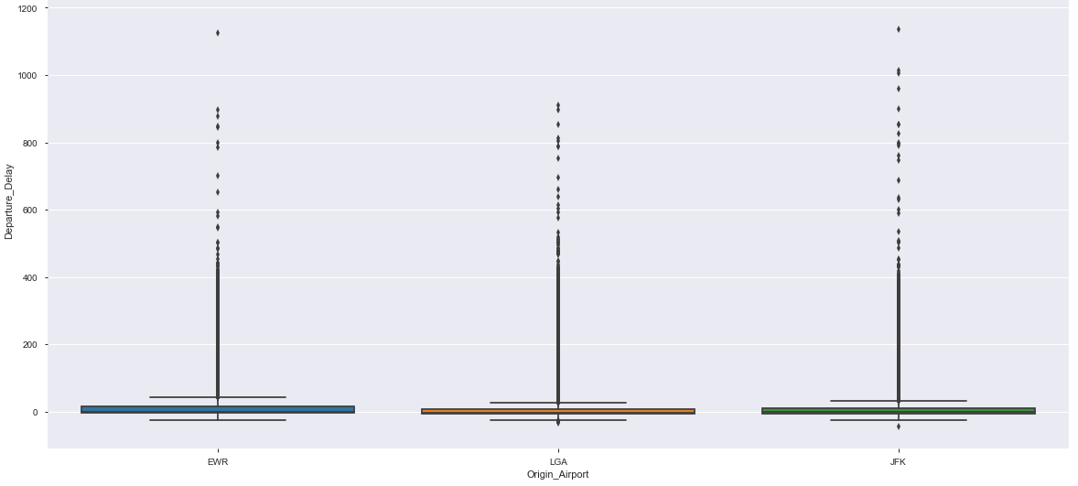
Sample 4
Departure Delays
Average Departure Delays
EWR airport is having highest average departure delays followed by JFK and LGA
LGA allows flights to depart with minimum delay (avg) making it fastest Departure Airport

Slide 6
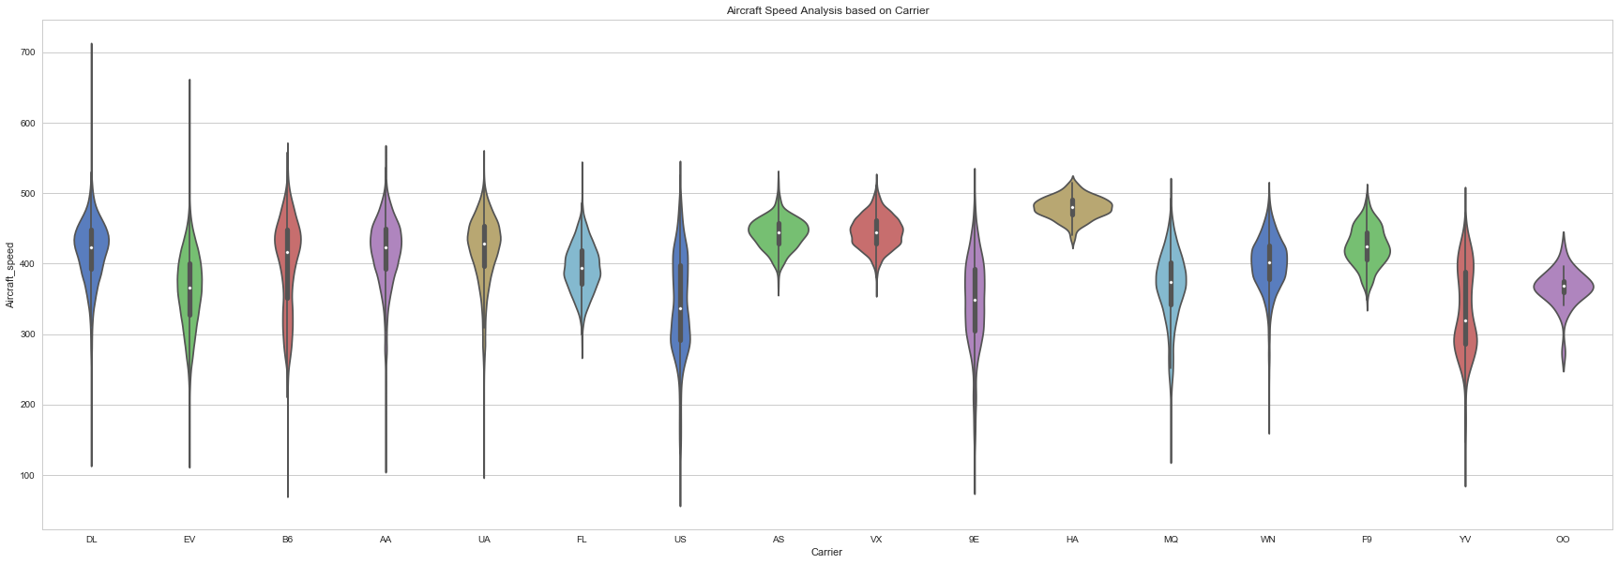
Sample 4
Aircraft Speed Analysis based on Carrier
Aircraft Speed
Minimum Speed – 76 Miles/Hour , Carrier = US
Maximum Speed – 703 Miles/Hour , Carrier = DL
Flights Speed variation based on Carrier details as below

Slide 7
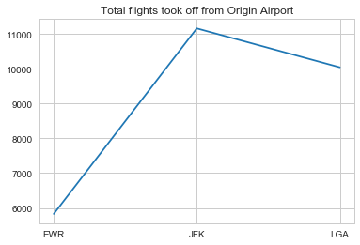
Sample 4
Total flights took off from Origin Airport
Flights Frequency from Origin Airport
JFK is busiest Airport in terms of maximum flights taking off
LGA is busy in comparison to EWR
EWR is having lowest flights departed compared to JFK,LGA

Slide 8
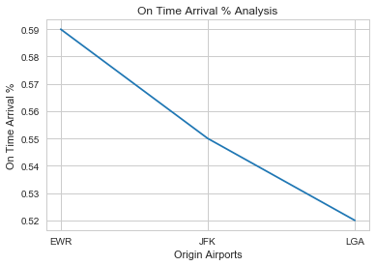
Sample 4
On Time Arrival Analysis
On Time Arrival Percentage of Airports ( Based on Stats)
JFK ( Maximum Flights taking off with 2nd On Time Arrival) – BEST AIRPORT
LGA (High number of Flights taking off with 3rd On time Arrival)
EWR ( Least flights took off with Maximum On Time arrival) – Less Frequent Airport

Slide 9
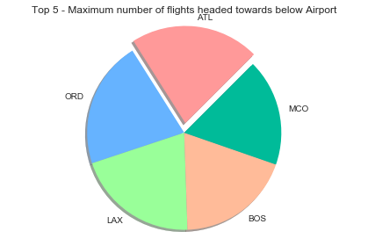
Sample 4
Top 5 - Maximum number of flights headed towards Destination
Flights Frequency towards Destination
ATL having maximum number of flights headed towards

Slide 10
Sample 4
Thank you
Project submitted by:
Varun Marvah (Varun.Marvah@gmail.com)

